Slide 1

Mars Rover Project Design Specification
Group 8
J. Kohlhase, A. Toader, G. Gyurchev, A. Malik, T. Pllaha, R. Karna
Notes:
Alphabetical order, put initials, slide numbers

Slide 2
Introduction
Control of rover on Mars
Telemetry data server
Martian Terrain & Martians
Reach Home Base Safely
Notes:
Map with walle + Project Outline instead

Slide 3
Motivation : Design Principles
Simple design for ease of implementation
Extensible and adaptable
Easily understandable and convenient
Reliable via rigorous testing
Notes:
Design Principles

Slide 4
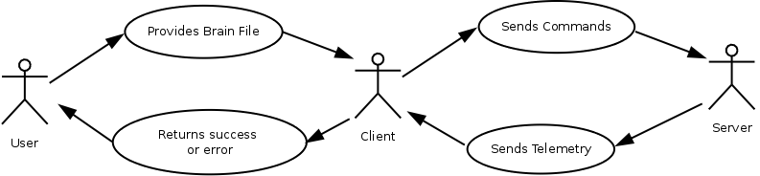
Use Case

Slide 5
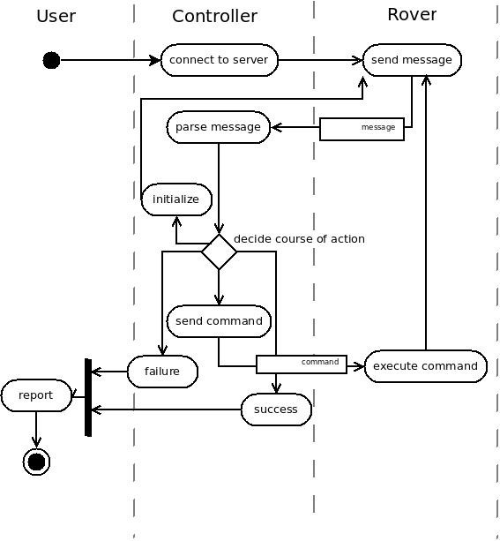
Activity Diagram
Notes:
Between parse message

Slide 6
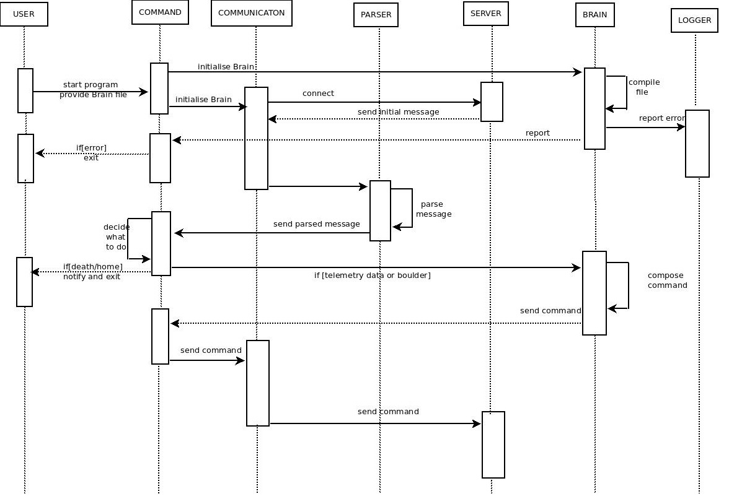
User
Command
Communication
Parser
Server
Brain
Logger

Slide 7
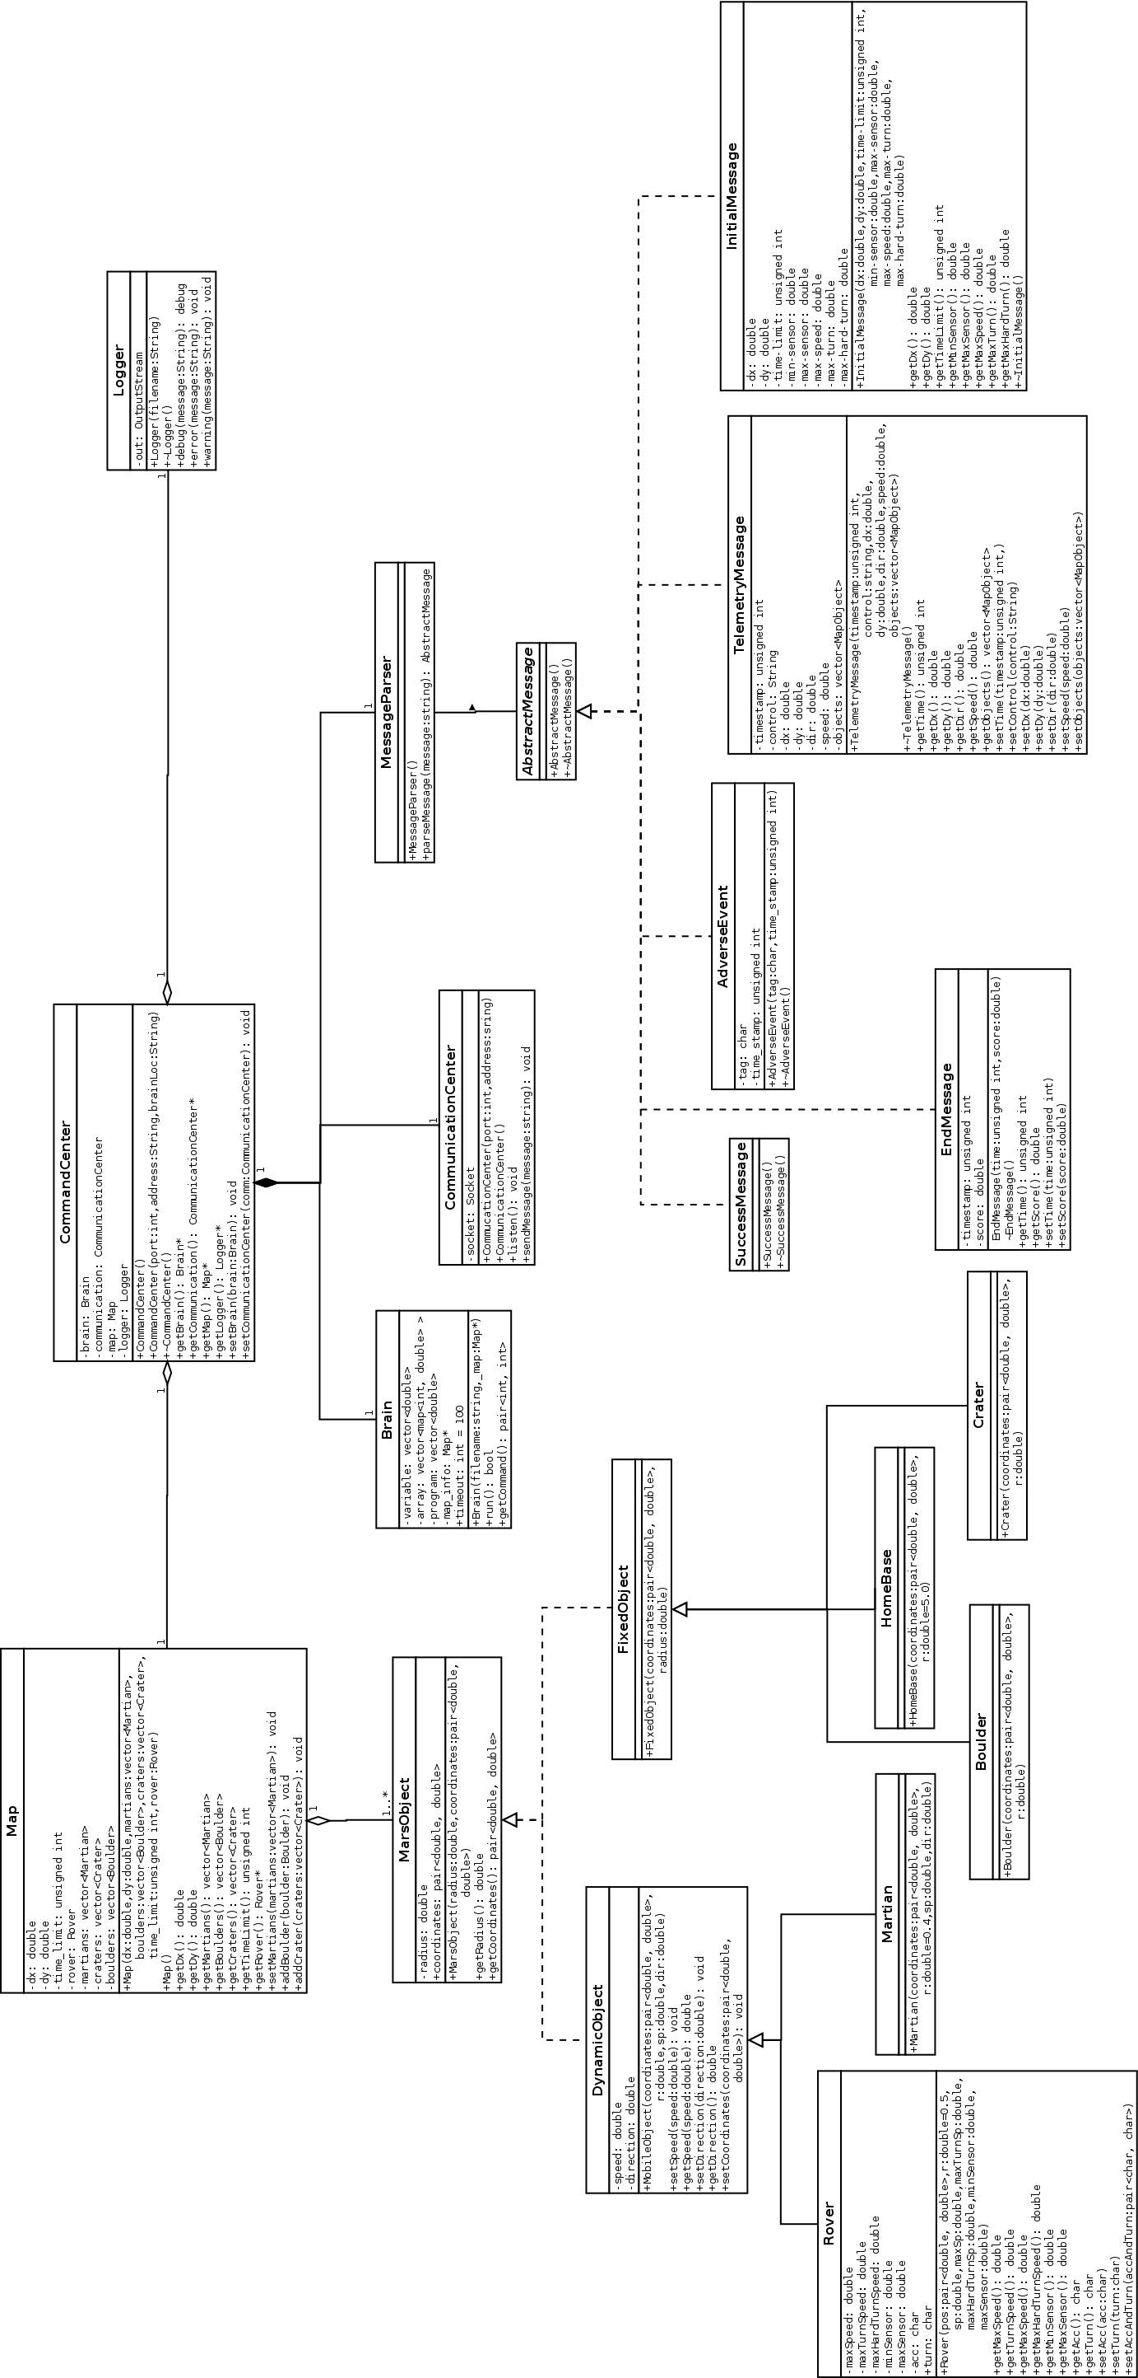
Notes:
Make it smaller, compactify.

Slide 8
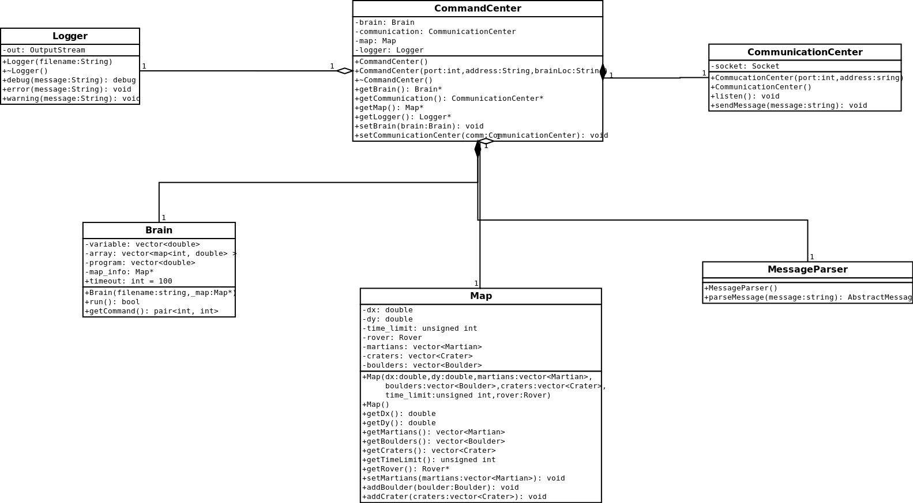
Core Classes
Notes:
More compact so that the writing is bigger.

Slide 9
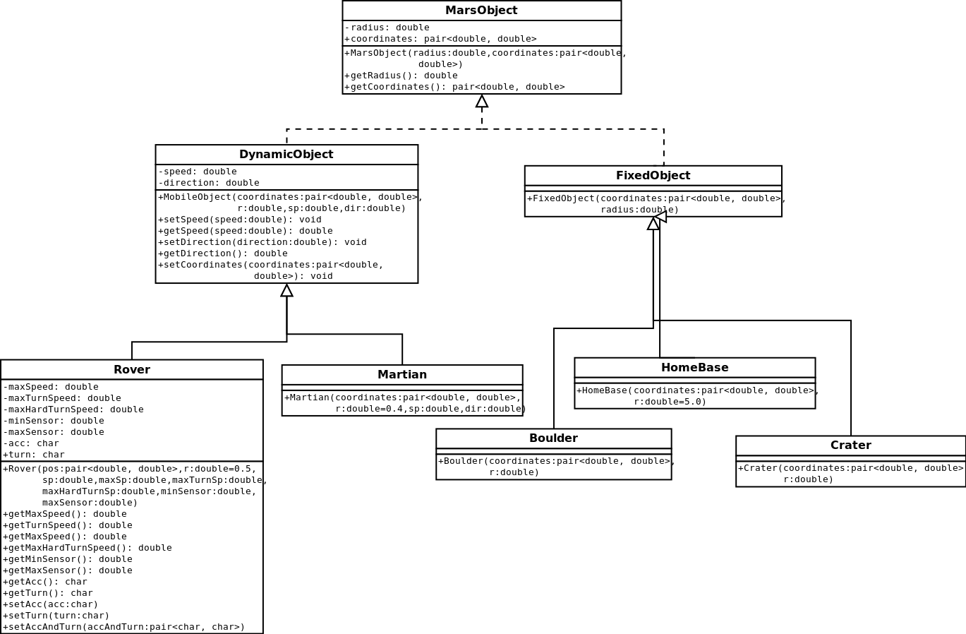
Mars Object Classes
Notes:
Class names bigger.

Slide 10
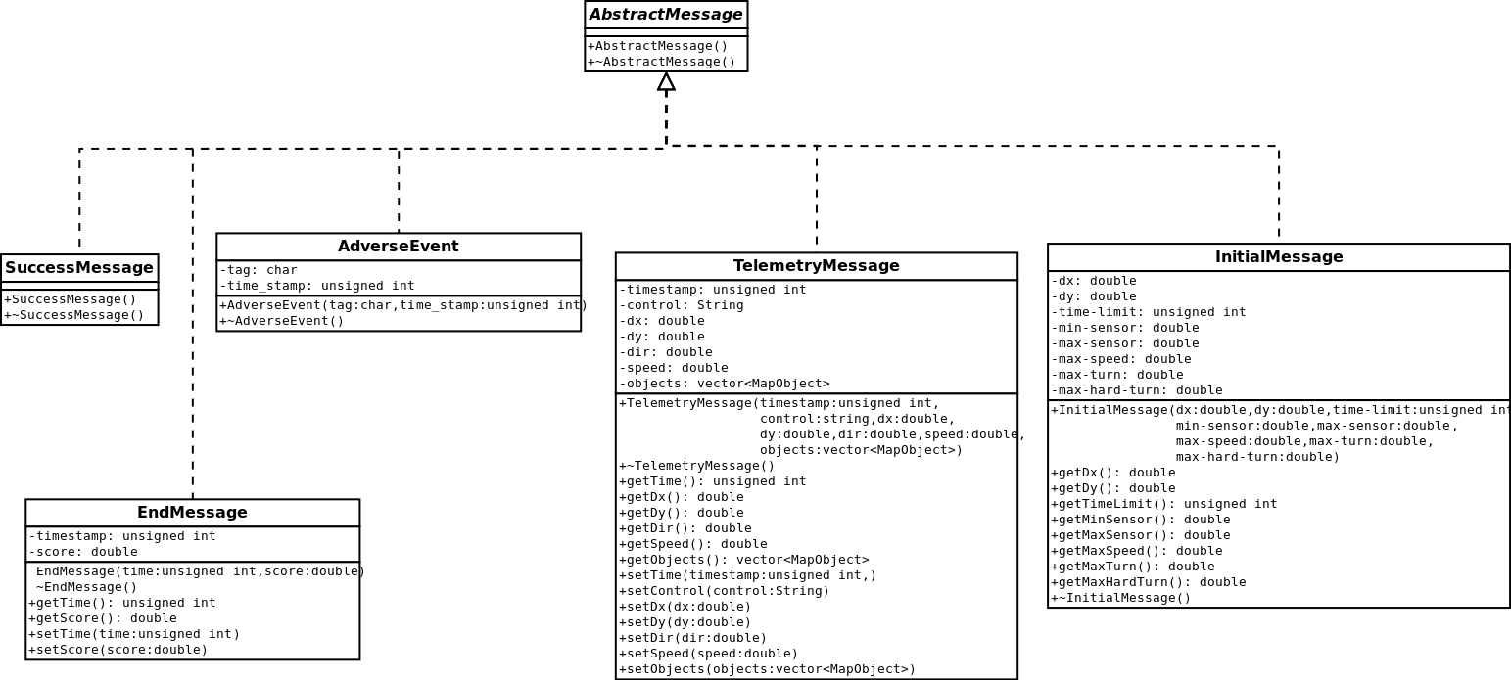
Message Classes
Notes:
Bigger class names.

Slide 11
Language Specifications: Features
User friendly
Variables
Array support
Expressions
If statements
While loops

Slide 12
Language Specifications: Variables
No declaration
All of type double
Single letter names
Values stored for further runs
Notes:
Georgi: tell us why you think this is better than other options. All the keywords should be here.

Slide 13
Language Specifications: Arrays
Examples
X[i]
t[p2+]
y[ij+]
k[5m*n+]
s[a[i]x*]
No declaration
Single letter names
C-like access
Expressions in indexes
Values stored for further runs
Notes:
The constructs look random. We think you should put it somewhere else. Put them in a box called Examples.

Slide 14
Language Specifications: Information Access
Map information
Set of predefined variables and arrays
Names start with $
Commands
Two special variables:
$mapdx
$time
$maxspeed
_acc and _rot
Notes:
What are the two special variables. Give examples of $ variables.

Slide 15
Language Specifications: Operators
Basic arithmetic operators
Square root
Sin(x) and Cos(x)
Angle calculation
Logic operators
+ - * / %
#
{ }
\
< > = ! & |
Notes:
Aligned.

Slide 16
Language Specifications: Expressions
Postfix notation
Easily parsable
Extremely flexible
Notation
Examples
a+b
ab+
d2%!
(a+b)*c
ab+c*
ab<cd=&!
(a+b)*c
ab+c*
xy\{3.14(2)**
Notes:
Make a list. The examples are too randomly placed on the slide. Introduce an example box.

Slide 17
Language Specifications: Setting values
Variables
Arrays
v:=10.3
set v 10.3
_rot:=1
set _rot 1
a[i+1]:=2*x
set_a a i1+ 2x*
a[b[j]]:=0
set_a a b[j] 0

Slide 18
Language Specifications: If Statements
Syntax
if <expr>
then
<statements>
else
<statements>
endif
Example
if a3<
then
set x 1x+
set p 0
else
set_a b a k[a1+]
endif
Notes:
Maybe you can use indentation.

Slide 19
Language Specifications: While loops
Syntax
while <expr>
<statements>
end
Example
set i 1
set s 0
while i11< set s sa[i]+
set i i1+
end
Notes:
INDENTATION!!!

Slide 20
Language Specifications: Compilation and Runtime
Transformation into lower-level language
Compiled program stored into a single array
Simple stack memory for expressions
Brain time limit during runtime. Can be modified by user
Notes:
Explain the time limit feature. Why is it for? Make sure the format is consistent.

Slide 21
MessageParser::parseMessage()
Create several strings:
Initial message format
Telemetry data format
Adverse event format
Success message format
Incorrect format
Pass these strings as arguments to MessageParser::parseMessage()
Check the type of the returned instance of AbstractMessage
Check the values of all attributes of the returned instance
Notes:
Format this page and put the header. Make the text box bigger.

Slide 22
Brain::run() && Brain::getCommand()
Initialize the brain with a simple Map object and a simple brain program that enters an infinite loop,
Call the Brain::getCommand() right after that line,
Expected Result:
Brain::run() should stop after timeout, and getCommand() should return a pair<int,int> which specifies new acceleration and turning states for the vehicle.

Slide 23
Integration Test
Create a mock-up server
Send strings of several formats (initial message, telemetry data etc..) as soon as a connection is established
Print responses on the screen.
Expected result:
A string of length 2 specifying a new acceleration state and a new turning state

Slide 24

System Test: Specification Fulfillment
No obstacles
Notes:
Same position for each map, Name the cases

Slide 25
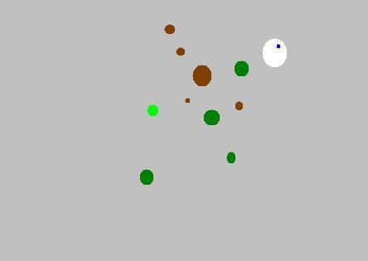
System Test: Path Finding (Static)
Elementary test for the path finding algorithm
Only static obstacles

Slide 26

System Test: Path Finding (Dynamic)
Test ability to avoid movable obstacles
Only martians

Slide 27
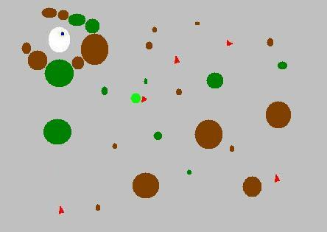
System Test: Path Finding (Horseshoe)
Horseshoe fence
More advanced test for the path finding algorithm
Notes:
Legend of colors..

Slide 28
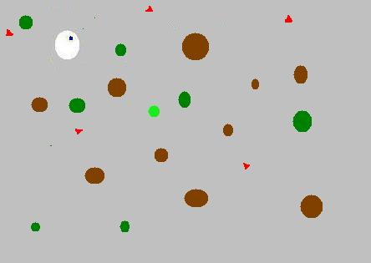
System Test: General Scenario
Random initialization of the map
Test for general scenarios

Slide 29
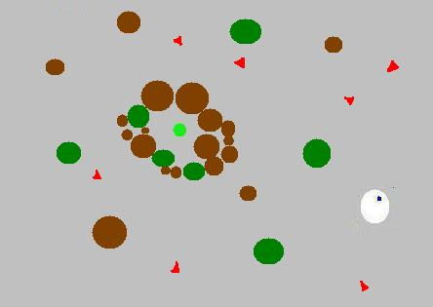
System Test: Extreme Scenario
Impossible to reach home
Measure the time the rover stays alive
Test security measures.

Slide 30
Conclusion
Extensibility
Ease of implementation
Robustness
Flexibility
Notes:
Thanks for your attention. Questions?
Moodle generator. Group 8 should be emphasized.

